Slide 1
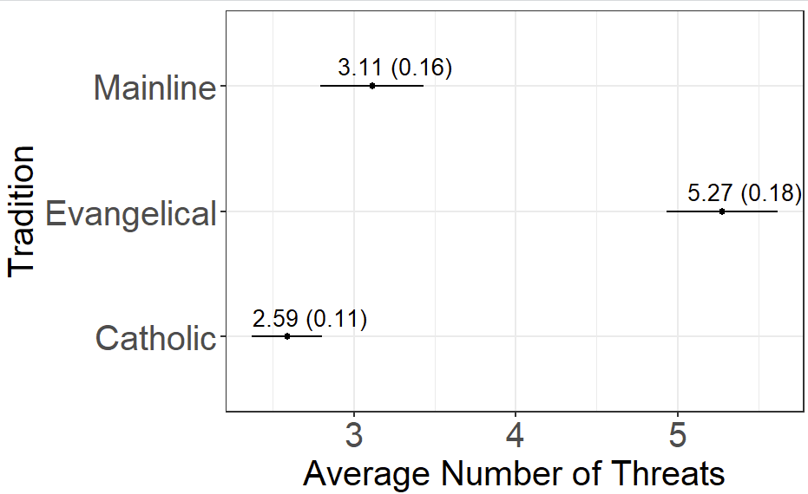
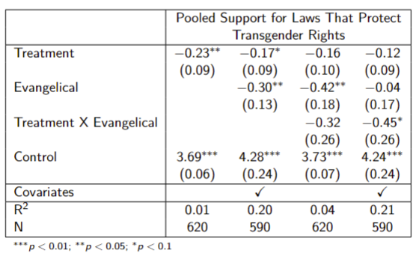
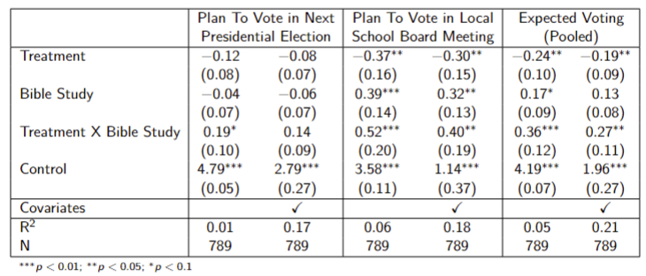
Paul Lendway Ph.D. Candidate, Department of Political Science, Yale University
Sermon Rhetoric and White Evangelical Support for the Republican Party
Puzzle
Theory
H1: Evangelical Protestant sermons will have a higher prevalence of cultural and elite threats.
H2: These threats will consist of a greater frequency of sin and politicization on the ideological right.
H3: Exposure to these threats will result in more conservative political attitudes and mobilization.
Puzzle: What is the role that local religious leaders
play in reinforcing the alignment between White
evangelicals and the Republican Party?
Research Design
Sermon Random Sample
Average Threats Per Sermon
Descriptive Analysis: I assess variation in sermon
threat content using a national random sample of
450 sermons from evangelical Protestant, mainline
Protestant, and Catholic traditions.
Experimental Analysis: I run a set of survey
experiments to assess the causal effect of sermon
exposure on political attitudes and mobilization.
Experiment One Results
Experiment Two Results
Conclusion
Relative to Catholic and mainline
Protestant sermons, evangelical
Protestant sermons contain more
cultural and elite threats.
These threats contain more sin
and politicization on the ideological right.
Exposure to these threats pushes
political attitudes in a more conservative
direction and increases mobilization
among Bible study attendees.

